Slide 1
Fast food and everything about him

Slide 2
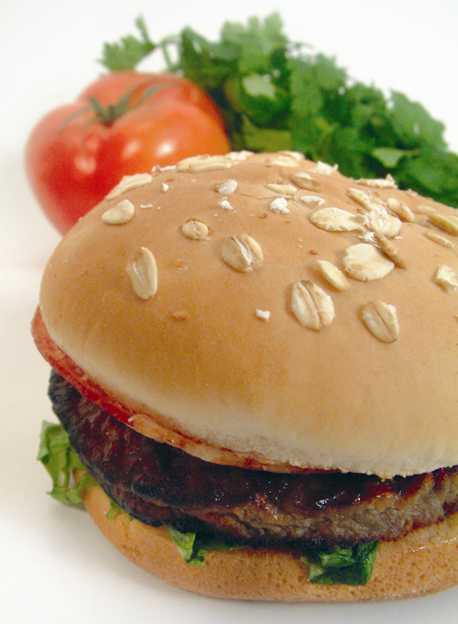
Fastfood (born fast food, fast food) - the class of fast food, usually offered by specialized institutions. The term "fast food" denote food that Fast can be cooked quickly and provide the client. The term "fast food" was first introduced in the Merriam-Webster dictionary in 1951.

Slide 3
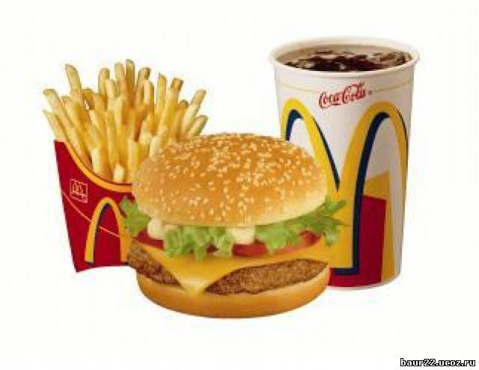
The history of fast food
Fast food was known in ancient Rome. In every town there was mass eateries and markets, where trading in all kinds of foods. One of the popular dishes are cakes of dough, smeared with olive oil (the prototype of Italian pizza), which are also used as an edible plate.
In China, the markets traded in a hot instant noodles (the prototype of modern). In India, Europe and Russia were popular variety of bread (as in Russia and cakes).

Slide 4
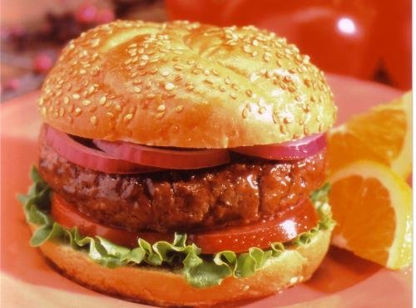
Fast food industry emerged in the 1920's in America. In 1921 the company opened in Kansas White Castle, a specialty which was unusual at the time of hamburgers. Sustained price (5 cents until 1946) and strange attracted buyers, and doubts about the safety of the product were dispelled by the cunning of the owner of Billy Ingram (when specifically recruited men in white coats gave the impression that even doctors are buying hamburgers). In the late 1940's, the company White Castle began to appear competitors, of which the most serious was the McDonald's.

Slide 5
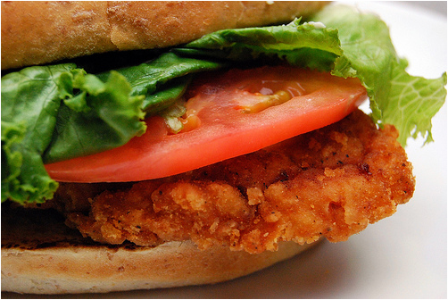
Impact on health
Fast food, according to Committee on Nutrition, Massachusetts Medical Society, especially vysokokalorien that leads to obesity and related diseases. Fast food is often rich in carcinogenic trans-saturated fats (margarine, kombizhir). Fast food contains a lot of fried foods (fries, and so n.), Also rich in carcinogens (acrylamide, etc.). High sugar content in soft drinks, rolls, etc., is dangerous not only for its caloric content, but also increased risk of developing diabetes and other diseases.
Semi-finished products are widely used in online fast-foods, as well as other food "factory" production, may contain a variety of chemical food additives.

Slide 6

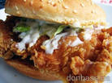
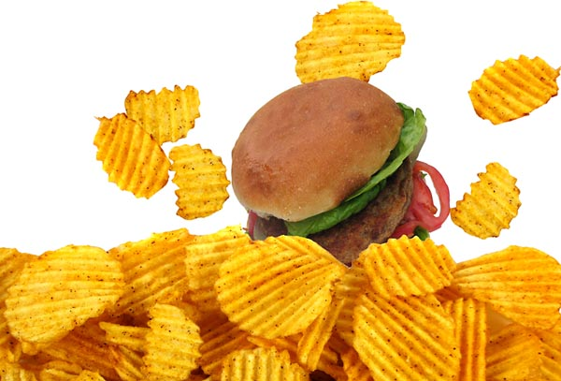
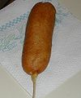








It hurts us all

