Slide 1
States of America: Alaska and California

Slide 2
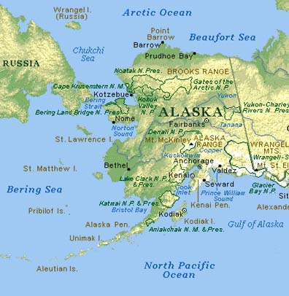
Alaska
Alaska is the largest state of the United States by area; it is situated in the northwest extremity of the North American continent, with Canada to the east, the Arctic Ocean to the north, and the Pacific Ocean to the west and south, with Russia further west across the Bering Strait. Approximately half of Alaska's 698,473 residents live within the Anchorage metropolitan area. As of 2009, Alaska remains the least densely populated state of the U.S.

Slide 3
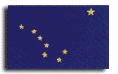
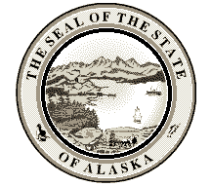
Area: 1530,7 thousand square kilometres
Capital: Juneau
Population: 626.932 persons
Largest cities: Anchorage, Juneau, Fairbanks, Sitka, Ketchikan, Kenai, Kodiak, Bethel, Wasilla, Barrow.

Slide 4
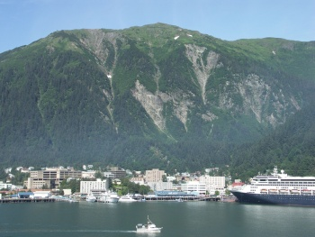
Alaska was loosely governed by the military initially, and was unofficially a territory of the United States from 1884 on. Alaska was officially proclaimed a state on January 3, 1959.

Slide 5
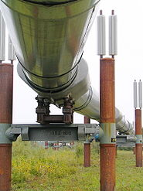
Alaska has vast energy resources. Major oil and gas reserves are found in the Alaska North Slope and Cook Inlet basins. The Trans-Alaska Pipeline can pump up to 2.1 million barrels of crude oil per day, more than any other crude oil pipeline in the United States.

Slide 6
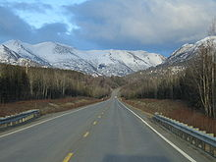
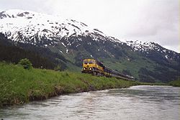
Alaska has few road connections compared to the rest of the U.S. The western part of Alaska has no road system connecting the communities with the rest of Alaska. Built around 1915, the Alaska Railroad played a key role in the development of Alaska through the 20th century.

Slide 7
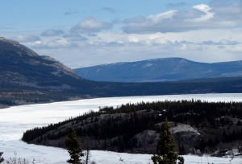
Alaska has more than three million lakes. The Bering Glacier complex near the southeastern border with Yukon covers 2,250 square miles alone. With over 100,000 of them, Alaska has half of the world's glaciers.

Slide 8
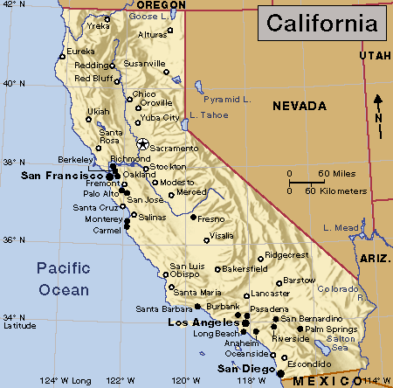
California
California is the most populous state in the United States and the third largest by area. It is located on the West Coast of the United States, and is bordered by Oregon to the north, Nevada to the northeast, Arizona to the southeast, the Mexican state of Baja California to the south, and the Pacific Ocean to the west.

Slide 9
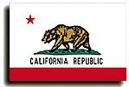
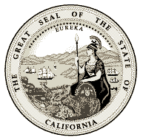
Capital: Sacramento
Area: 423,970 square kilometres
Population: 33871648 persons
Largest city: Los Angeles

Slide 10
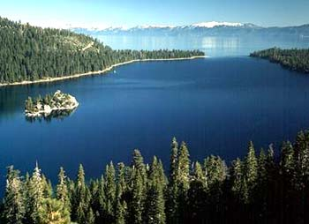
The most prominent rivers within California are the Sacramento River, the Pit River and the San Joaquin River, which drain the Central Valley and the west slope of the Sierra Nevada and flow to the Pacific Ocean through San Francisco Bay.

Slide 11
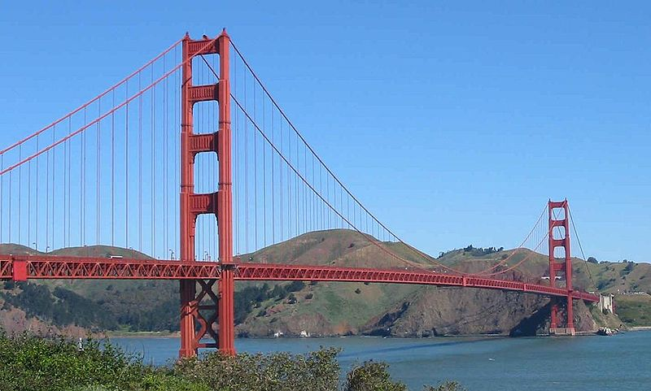
One of the state's more visible landmarks, the Golden Gate Bridge was completed in 1937. With its orange paint and panoramic views of the bay, this highway bridge is a popular tourist attraction and also accommodates pedestrians and bicyclists.

Slide 12
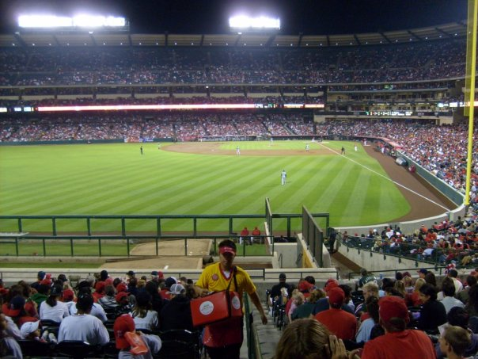
The San Francisco Bay Area has seven major league teams spread in three cities, San Francisco, Oakland and San Jose. While the Greater Los Angeles Area is home to ten major league franchises, it is also the largest metropolitan area not to have a team from the National Football League.

