Slide 1
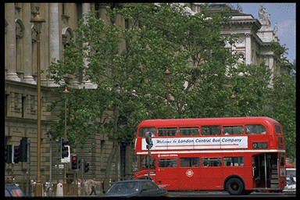
The United Kingdom
Of Great Britain
and Northern Ireland.
Executed:
Dronnikova Sveta
2010

Slide 2
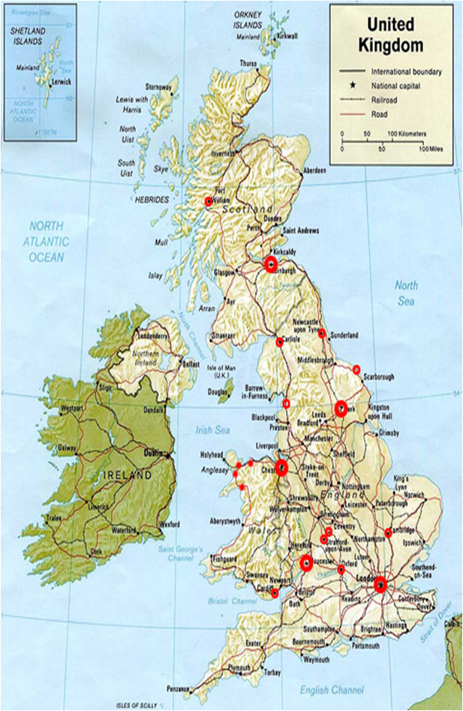
Britain is a parliamentary monarchy. Officially the head of the state is the king or queen.

Slide 3
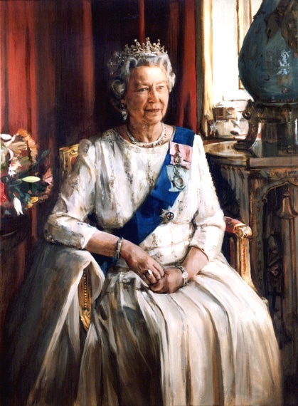
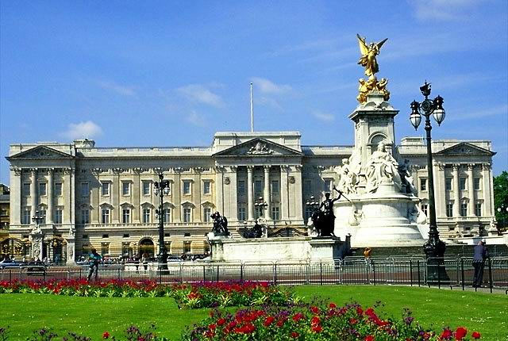
The UK is a constitutional monarchy. In low, the Head of State is the Queen. In practice, the Queen reigns, but does not rule. The country is ruled by the elected government with the Prime Minister at the head.
Buckingham Palace is the London home of the Queen. When the flag is flying on the top she is at home.

Slide 4
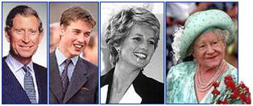
Prince Charles Prince William Princess Diana Queen Elizabeth The royal family

Slide 5
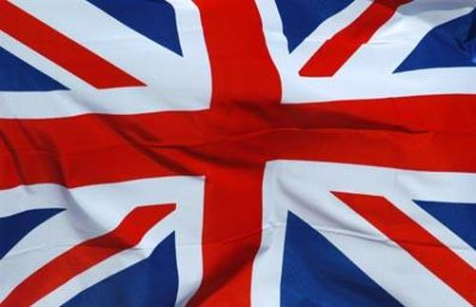
The flag of the United Kingdom is known as the Union Jack. It is made up of three crosses: the cross of St. George ( the patron saint of England), the cross of St. Andrew (the patron saint of Scotland) and the cross of St. Patrick (the patron saint of Ireland) .

Slide 6
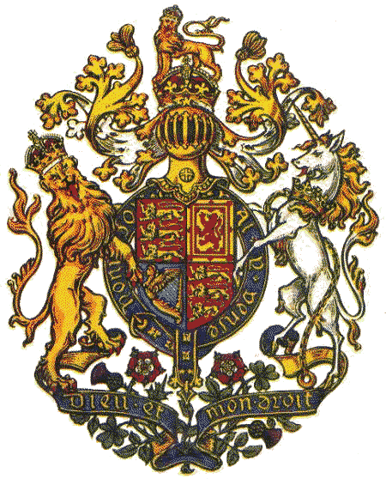
The Royal Coat of Arms of the United Kingdom is the official coat of arms of the British monarch, currently Queen Elizabeth II. These arms are used by the Queen in her official capacity as monarch, and are officially known as her Arms of Dominion. Variants of the Royal Arms are used by other members of the Royal Family; and by the British Government in connection with the administration and government of the country. In Scotland, the Queen has a separate version of the Royal Arms, a variant of which is used by the Scotland Office.

Slide 7
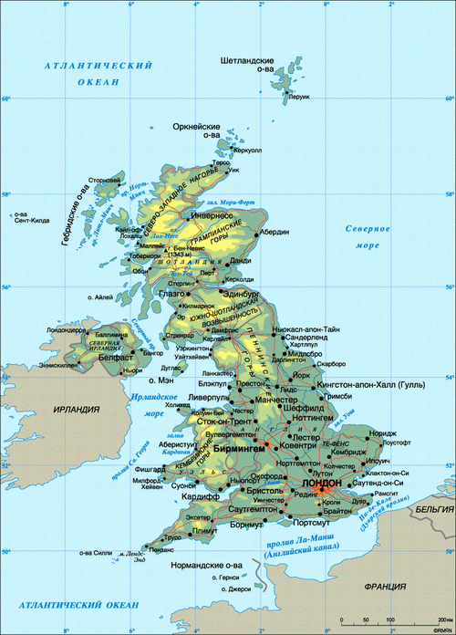
The UK consist of
4 countries:
England,
Scotland,
Wales
and
Northern Ireland.

Slide 8






FLAGS
Flags
England
Scotland
The UK
Wales
Northern Ireland

Slide 9

Geographical position
The United Kingdom of Great Britain and Northern Ireland is situated on the British Isles. The British Isles consist of 2 large islands, Great Britain and Ireland, and about 5000 small islands.
The British Isles are separated from the European continent by the North Sea and the English Channel. The western coast of Great Britain is washed by the Atlantic Ocean and the Irish Sea.
THE ATLANTIC OCEAN
the North Sea
GREAT BRITAIN
The Irish Sea
the English Channel

Slide 10
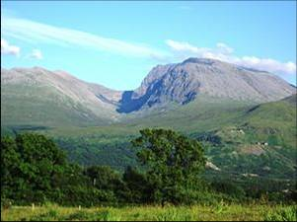
Mountains
The north and west of England are mountainous, but mountains are not very high. BEN NAVIS in Scotland is the highest mountain (1343 m)‏

Slide 11
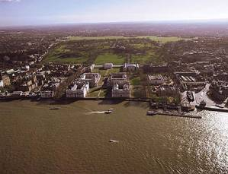
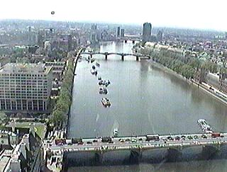
Rivers
There are a lot of rivers in the UK, but they are not very long.
The SEVERN is the longest river.
The THAMES is the deepest and the most important one.

Slide 12
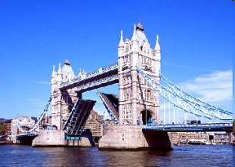
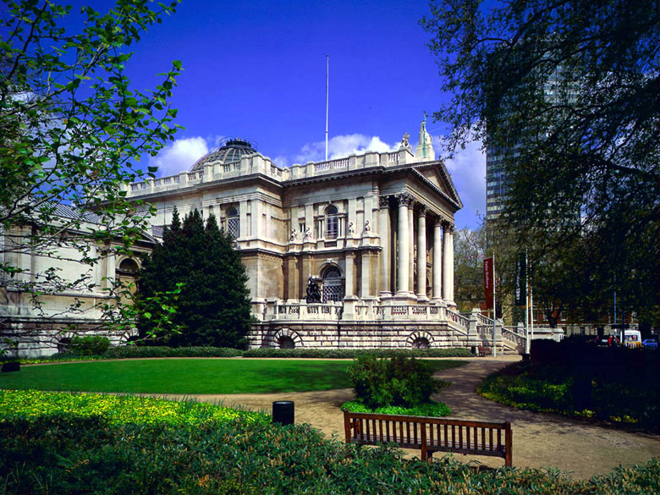
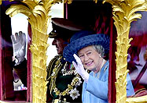
The capital of England is LONDON
Capitals

Slide 13
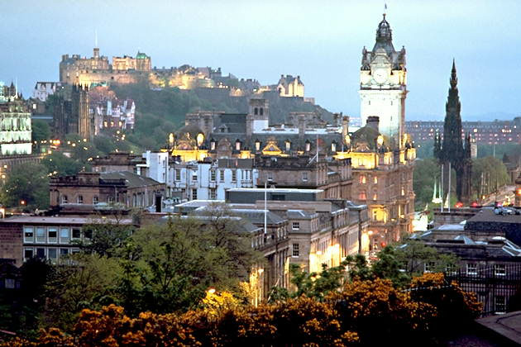
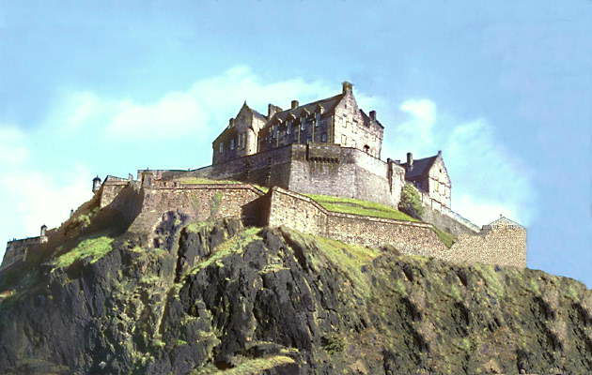
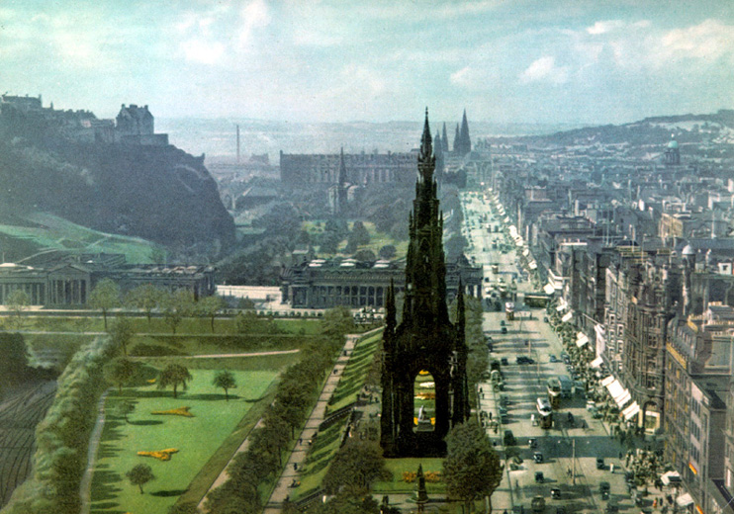
The capital of Scotland is EDINBURGH

Slide 14
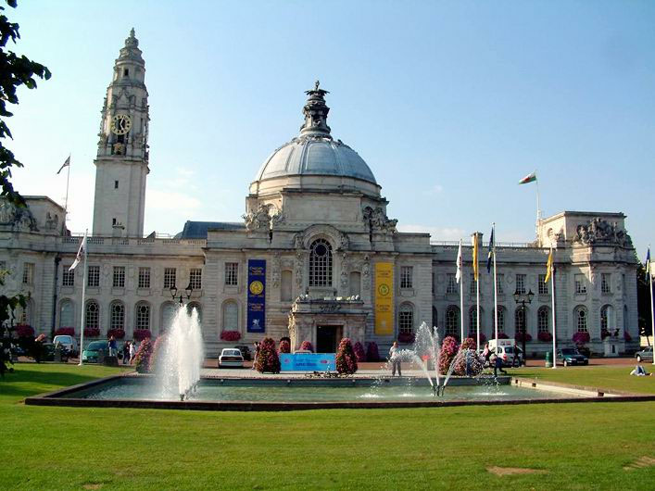
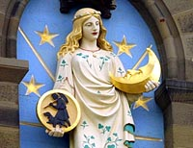
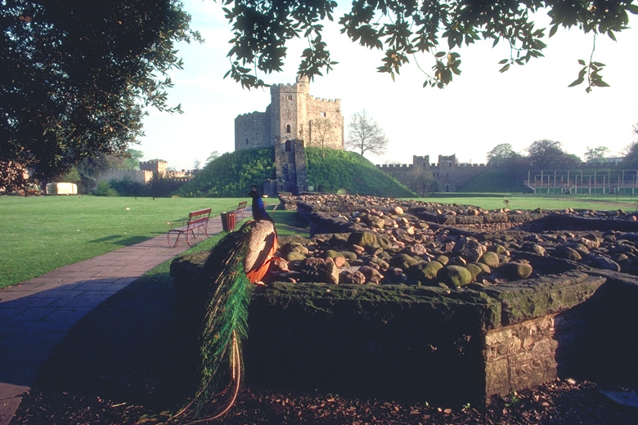
The capital of Wales is CARDIFF

Slide 15
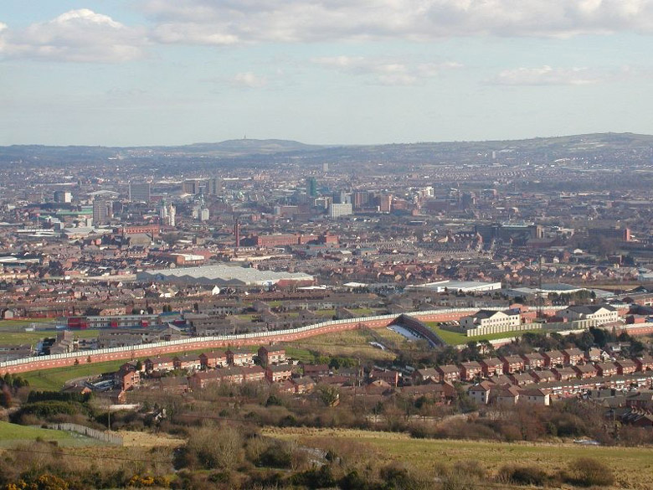

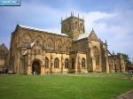
The capital of Northern Ireland is BELFAST

Slide 16




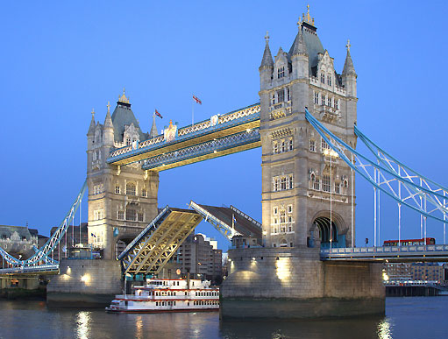
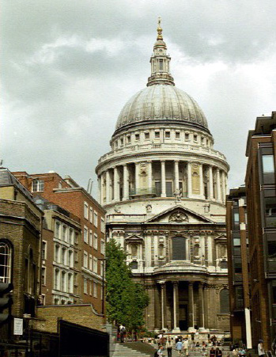

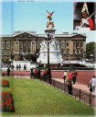
The capital of the UK is

Slide 17
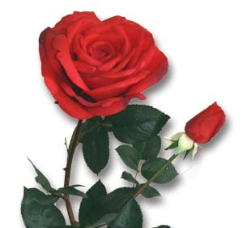
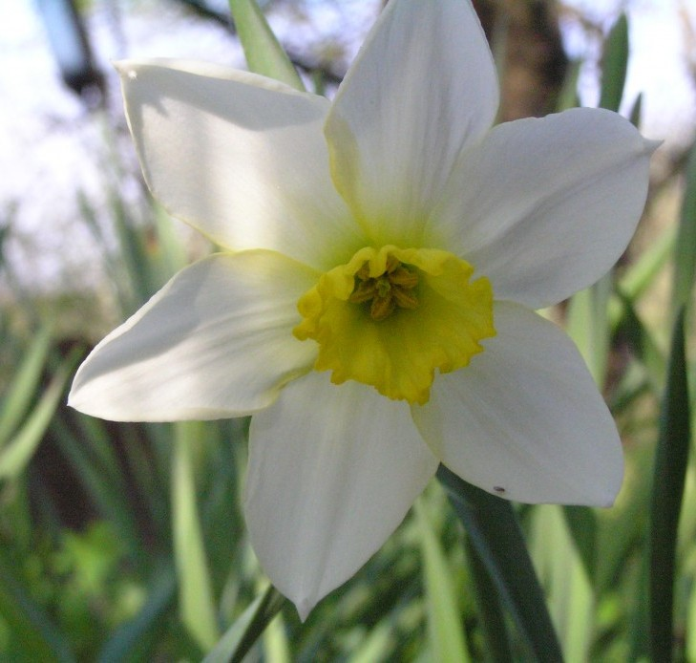
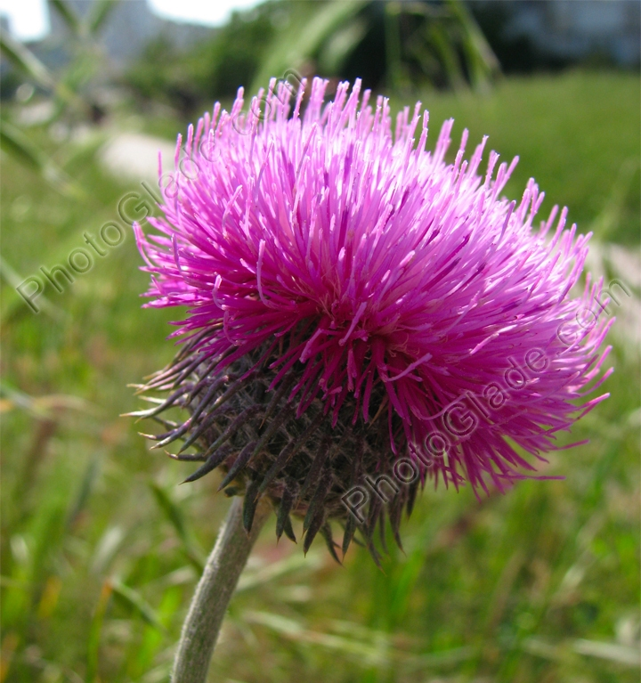

Symbols
the symbol of England is the red rose
the symbol of Wales is the daffodil
the symbol of Scotland is the thistle
The symbol of Nothern Ireland is the shamrock

Slide 18
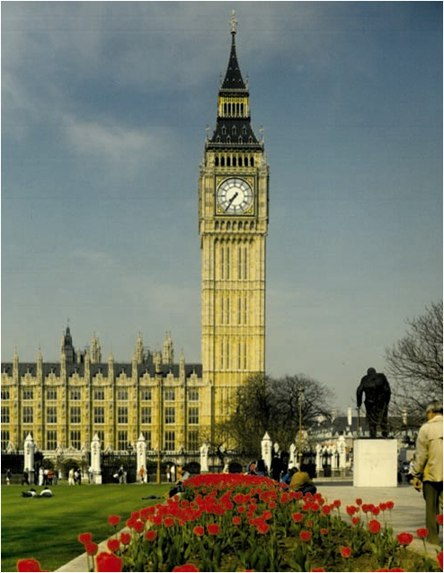
Sights
The Clock Tower called “Big Ben”, is known the world over. Its hour bell is named after Sir Benjamin Hall, the first Commissioners of Works.

Slide 19
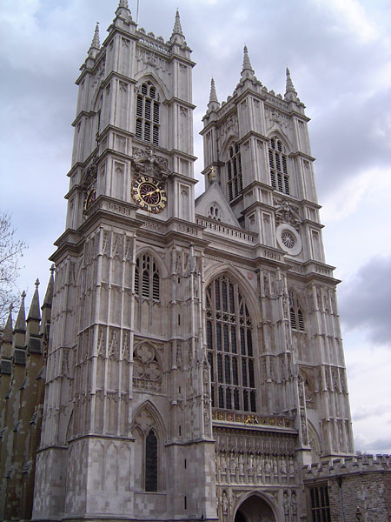
The Collegiate Church of St Peter at Westminster, which is almost always referred to popularly and informally as Westminster Abbey, is a large, mainly Gothic church, in Westminster, London, just to the west of the Palace of Westminster. It is the traditional place of coronation and burial site for English, later British and later still (and currently) monarchs of the Commonwealth Realms. It briefly held the status of a cathedral from 1546–1556, and is a Royal Peculiar.

Slide 20
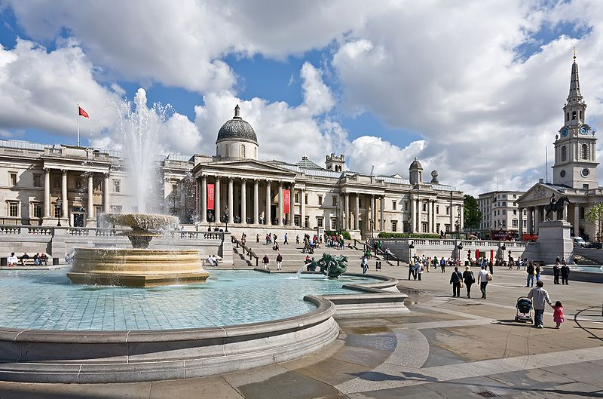
Trafalgar Square is a square in central London, England. With its position in the heart of London, it is a tourist attraction; and one of the most famous squares in the United Kingdom and the world. At its centre is Nelson's Column, which is guarded by four lion statues at its base. Statues and sculptures are on display in the square, including a fourth plinth displaying changing pieces of contemporary art, and it is a site of political demonstrations.

Slide 21
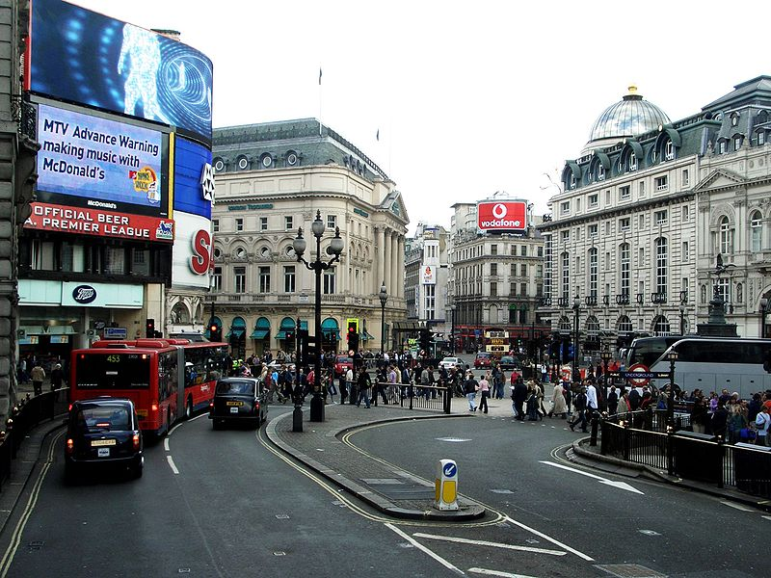
Piccadilly Circus is a famous road junction and public space of London's West End in the City of Westminster, built in 1819 to connect Regent Street with the major shopping street of Piccadilly. In this context a circus, from the Latin word meaning a circle, is a circular open space at a street junction

Slide 22
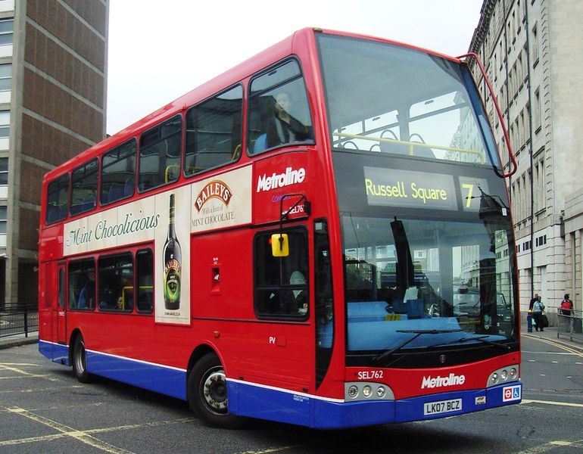
London Buses is the subsidiary of Transport for London (TfL) that manages bus services within Greater London, UK. Buses are required to carry similar red colour schemes and conform to the same fare scheme. Most services are provided by private sector operators.

Slide 23
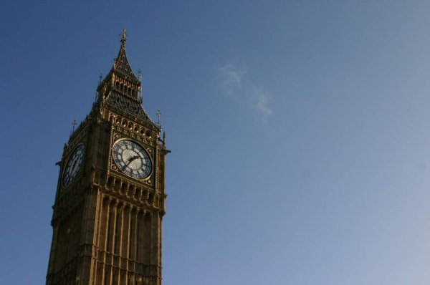
The End

