Slide 1
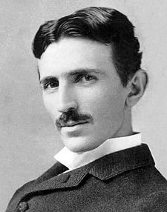
Nikola Tesla

Slide 2
Nikola Tesla
Nikola Tesla (Serbian; 10 July 1856 – 7 January 1943) was an inventor, mechanical engineer, and electrical engineer. His work helped usher in the Second Industrial Revolution.

Slide 3
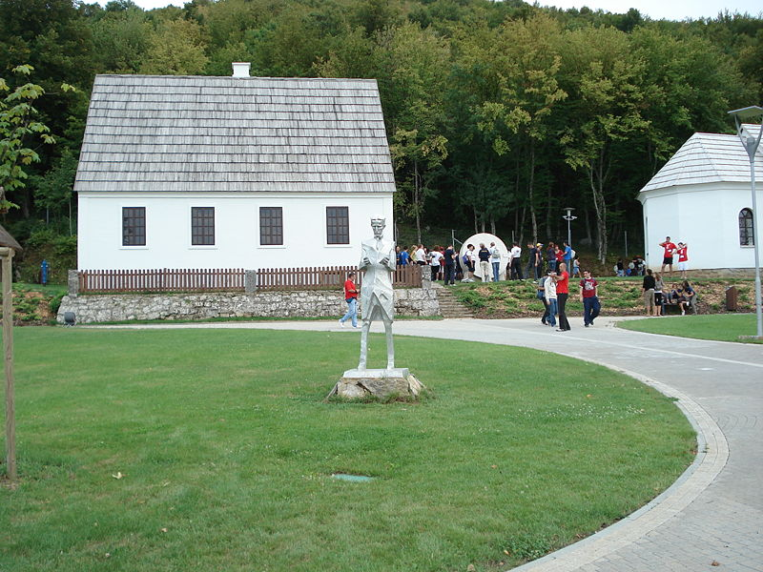
Early years
Tesla was born to Serbian parents in the village of Smiljan, Austrian Empire near the town of Gospić, in the territory of modern-day Croatia. Nikola was the fourth of five children, having one older brother and three sisters. His family moved to Gospić in 1862. Tesla attended school at Higher Real Gymnasium in Karlovac.[11] He finished a four-year term in the span of three years.

Slide 4
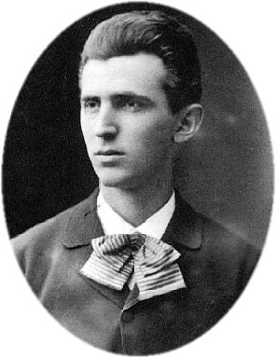
Education
Tesla then studied electrical engineering at the Austrian Polytechnic in Graz (1875). While there, he studied the uses of alternating current. Some sources say he received Baccalaureate degrees from the university at Graz. Tesla was later persuaded by his father to attend the Charles-Ferdinand University in Prague, which he attended for the summer term of 1880. Here, he was influenced by Ernst Mach. However, after his father died, he left the university, having completed only one term.

Slide 5
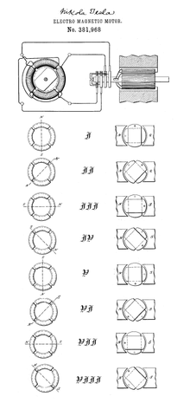
France
In 1882 he moved to Paris, to work as an engineer for the Continental Edison Company, designing improvements to electric equipment brought overseas from Edison's ideas. According to his autobiography, in the same year he conceived the induction motor and began developing various devices that use rotating magnetic fields for which he received patents in 1888.

Slide 6
United States
On 6 June 1884, Tesla first arrived in the United States, in New York City with little besides a letter of recommendation from Charles Batchelor, a former employer. In the letter of recommendation to Thomas Edison, Batchelor wrote, "I know two great men and you are one of them; the other is this young man." Edison hired Tesla to work for his Edison Machine Works. Tesla's work for Edison began with simple electrical engineering and quickly progressed to solving some of the company's most difficult problems. Tesla was even offered the task of completely redesigning the Edison company's direct current generators.

Slide 7
Middle years
In 1886, Tesla formed his own company, Tesla Electric Light & Manufacturing. The initial financial investors disagreed with Tesla on his plan for an alternating current motor and eventually relieved him of his duties at the company. Tesla worked in New York as a laborer from 1886 to 1887 to feed himself and raise capital for his next project. In 1887, he constructed the initial brushless alternating current induction motor, which he demonstrated to the American Institute of Electrical Engineers (now IEEE) in 1888. In the same year, he developed the principles of his Tesla coil, and began working with George Westinghouse at Westinghouse Electric & Manufacturing Company's Pittsburgh labs. Westinghouse listened to his ideas for polyphase systems which would allow transmission of alternating current electricity over long distances.

Slide 8
X-rays
In April 1887, Tesla began investigating what would later be called X-rays using his own single terminal vacuum tubes (similar to his patent #514,170). This device differed from other early X-ray tubes in that it had no target electrode. The modern term for the phenomenon produced by this device is bremsstrahlung (or braking radiation). We now know that this device operated by emitting electrons from the single electrode through a combination of field electron emission and thermionic emission. Once liberated, electrons are strongly repelled by the high electric field near the electrode during negative voltage peaks from the oscillating HV output of the Tesla Coil, generating X rays as they collide with the glass envelope. He also used Geissler tubes. By 1892, Tesla became aware of the skin damage that Wilhelm Röntgen later identified as an effect of X rays.

Slide 9
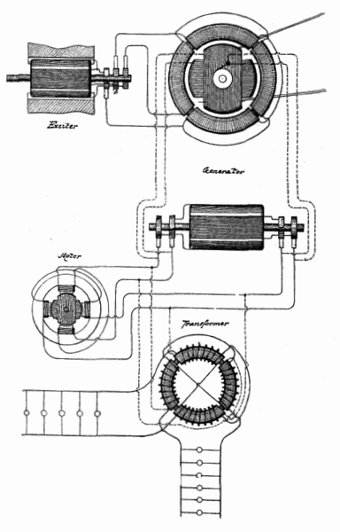
From 1893 to 1895
From 1893 to 1895, he investigated high frequency alternating currents. He generated AC of one million volts using a conical Tesla coil and investigated the skin effect in conductors, designed tuned circuits, invented a machine for inducing sleep, cordless gas discharge lamps, and transmitted electromagnetic energy without wires, building the first radio transmitter. In St. Louis, Missouri, Tesla made a demonstration related to radio communication in 1893. Addressing the Franklin Institute in Philadelphia, Pennsylvania and the National Electric Light Association, he described and demonstrated in detail its principles.

Slide 10
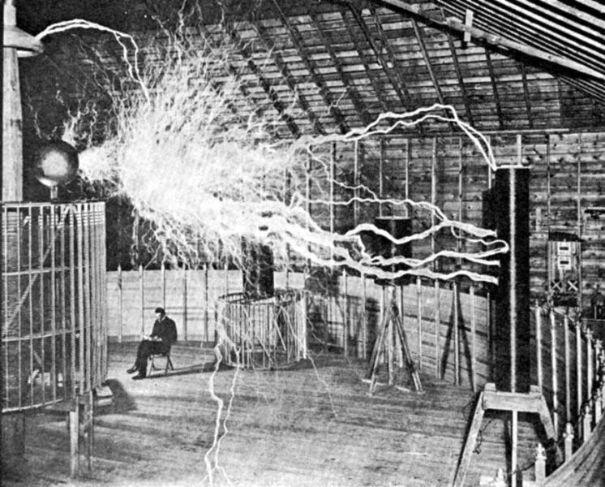
Colorado Springs

Slide 11
Experiments
In 1899, Tesla decided to move and began research in Colorado Springs, Colorado in a lab located near Foote Ave. and Kiowa St., where he would have room for his high-voltage, high-frequency experiments. Upon his arrival he told reporters that he was conducting wireless telegraphy experiments transmitting signals from Pikes Peak to Paris. Tesla's diary contains explanations of his experiments concerning the ionosphere and the ground's telluric currents via transverse waves and longitudinal waves.At his lab, Tesla proved that the earth was a conductor, and he produced artificial lightning (with discharges consisting of millions of volts, and up to 135 feet long).

Slide 12
Schumann resonance
Tesla researched ways to transmit power and energy wirelessly over long distances (via transverse waves, to a lesser extent, and, more readily, longitudinal waves). He transmitted extremely low frequencies through the ground as well as between the Earth's surface and the Kennelly–Heaviside layer. He received patents on wireless transceivers that developed standing waves by this method. In his experiments, he made mathematical calculations and computations based on his experiments and discovered that the resonant frequency of the Earth was approximately 8 hertz (Hz). In the 1950s, researchers confirmed that the resonant frequency of the Earth's ionospheric cavity was in this range (later named the Schumann resonance).

Slide 13
Colorado Springs
In the Colorado Springs lab, Tesla observed unusual signals that he later thought may have been evidence of extraterrestrial radio wave communications coming from Venus or Mars.He noticed repetitive signals from his receiver which were substantially different from the signals he had noted from storms and earth noise. Specifically, he later recalled that the signals appeared in groups of one, two, three, and four clicks together. Tesla had mentioned that he thought his inventions could be used to talk with other planets. There have even been claims that he invented a "Teslascope" for just such a purpose. It is debatable what type of signals Tesla received or whether he picked up anything at all. Research has suggested that Tesla may have had a misunderstanding of the new technology he was working with,or that the signals Tesla observed may have been non-terrestrial natural radio source such as the Jovian plasma torus signals.

Slide 14
Directed-energy weapon
Later in life, Tesla made remarkable claims concerning a “ teleforce " weapon . The press called it a "peace ray" or death ray . In total, the components and methods included.
An apparatus for producing manifestations of energy in free air instead of in a high vacuum as in the past. This, according to Tesla in 1934, was accomplished.
A mechanism for generating tremendous electrical force. This, according to Tesla, was also accomplished.
A means of intensifying and amplifying the force developed by the second mechanism.
A new method for producing a tremendous electrical repelling force. This would be the projector, or gun, of the invention.

Slide 15
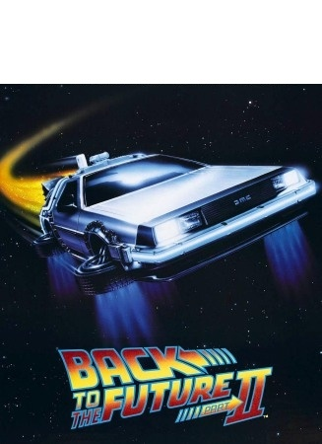
Theoretical inventions
Another of Tesla's theorized inventions is commonly referred to as Tesla's Flying Machine, which appears to resemble an ion-propelled aircraft.Tesla claimed that one of his life goals was to create a flying machine that would run without the use of an airplane engine, wings, ailerons, propellers, or an onboard fuel source. Initially, Tesla pondered about the idea of a flying craft that would fly using an electric motor powered by grounded base stations. As time progressed, Tesla suggested that perhaps such an aircraft could be run entirely electro-mechanically. The theorized appearance would typically take the form of a cigar or saucer.

Slide 16
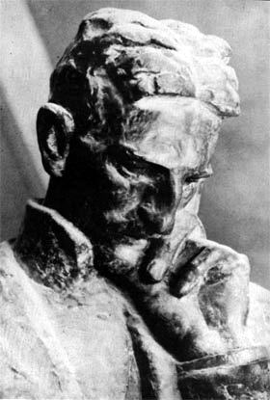
Death
The urn with Tesla's ashes in Nikola Tesla Museum in Belgrade
Tesla died of heart failure alone in room 3327 of the New Yorker Hotel, on 7 January 1943.Despite having sold his AC electricity patents, Tesla died with significant debts. Later that year the US Supreme Court upheld Tesla's patent number 645576 in a ruling that served as the basis for patented radio technology in the United States.
Tesla's funeral took place on 12 January 1943, at the Cathedral of Saint John the Divine in Manhattan, New York City. His body was cremated and his ashes taken to Belgrade, Serbia, then-Yugoslavia in 1957. The urn was placed in the Nikola Tesla Museum in Belgrade.

