Slide 1
UNEMPLOYMENT IN BELARUS

Slide 2
The employment assistance programme of the Republic of Belarus for 2008.
The objective consists of two indissolubly united parts – to make sure that the number of economically active population reaches 4.535 million and to curb the unemployment rate in the socially accepted bounds that is 1.2-1.4%.
According to the programme, 155 thousand jobs will be created with the help of different sources of financing (2.9 thousand of them will account for budget loans). In small towns up 21.9 thousand new jobs will be created.

Slide 3
The programme prioritizes employment assistance for the most vulnerable groups of population, including women and the youth. This will be achieved through a series of practical measures adopted by the programme:
professional training
re-training
raising the level of skills of the unemployed to meet the needs of particular employers.
The total budget of the programme exceeds Br178.2717 billion. The money has been allocated from:
the Social Security Fund of the Ministry of Labour and Social Protection (almost Br117.6266 billion)
local budgets (Br18.0586 billion)
own resources of employers (Br40.2075 billion)
bank loans (Br3.379 billion)
The Ministry of Labour and Social Protection, the Minsk oblast and district executive committees are commissioned with the task to supervise the implementation of the programme and to make sure that all the resources will be used appropriately.

Slide 4
Unemployment Rate.
Chairman of the Federation of Trade Unions of Belarus (FTUB) Leonid Kozik informed participants of the 97th session of the International Labour Organisation (ILO) in Geneva about a record low unemployment rate in Belarus.
Leonid Kozik informed participants of the session about the country’s most important achievements in fulfilling ILO appeals for establishing proper working conditions. In particular, the record low unemployment (1%) was mentioned as well as the absence of child labour and sex discrimination and many other things.

Slide 5
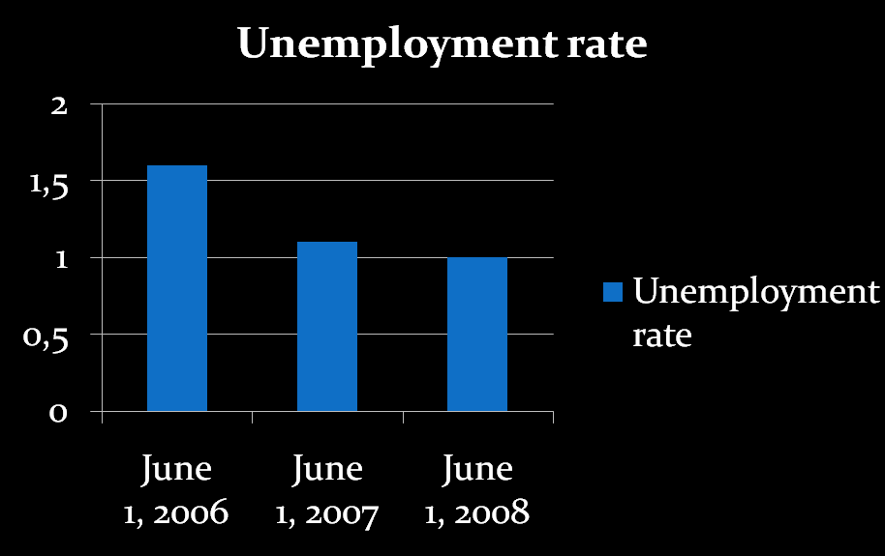
The unemployment rate in Belarus remains at 1% of the economically active population.

Slide 6
The unemployment rate has been falling down in Belarus.
According to the statistical data, as of June 1 this year, 44,900 unemployed were registered with the employment assistance service, down 5.9% from June 1 last year. The demand for the workforce has been on the rise. The number of jobs in the job bank of the state employment assistance service increased by 21.2% to 59,400 (in April an increase was 3,100, in May 5,100 jobs).
The stabilization in the labour market was due to the stable economic performance of the country and effective employment assistance policy, Nikolai Kokhonov (the chief of the main department of the employment policy and population of the Ministry of Labour and Social Security) said.

Slide 7
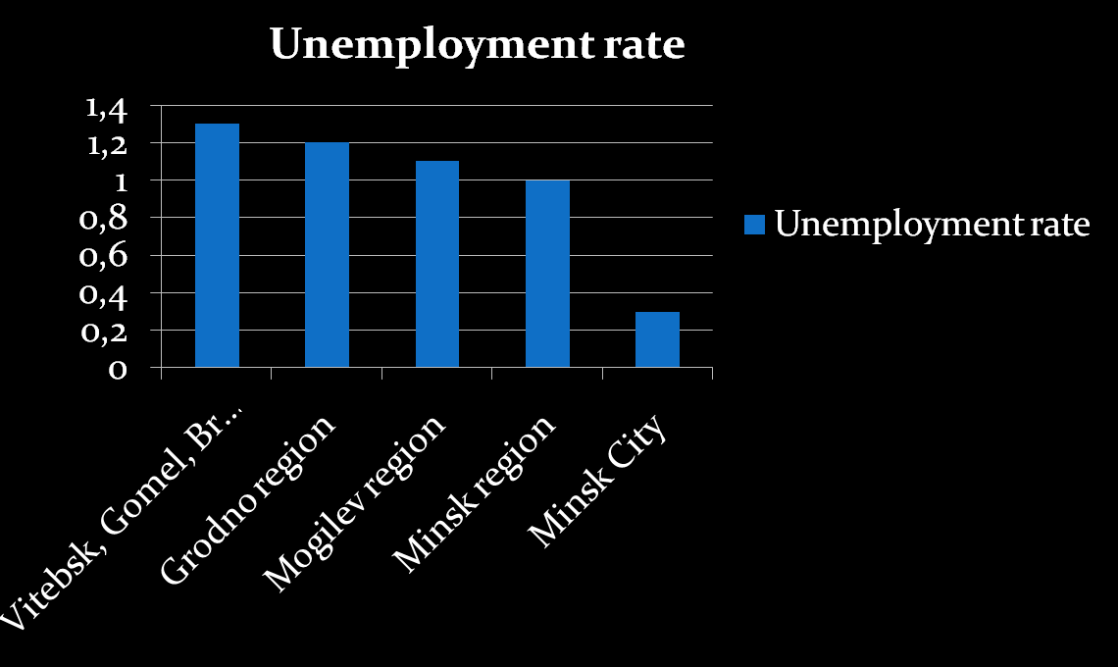
As of June 1 the jobless rate in the Vitebsk, Gomel and Brest regions was at the level of 1.3%. The unemployment in the Grodno region was 1.2%, in the Mogilev region - 1.1%, Minsk region -1% and in the city of Minsk - 0.3% of the economically active population.

Slide 8
Female Unemployment.
The number of unemployed women in Belarus is gradually shrinking. As of July 1 this year the female unemployment was 27,000 (1,500 down in June; 1,700 in May and 1,000 down in March). The greatest part of the jobless women accounted for the Brest and Gomel regions (5.4 thousand and 5.3 thousand respectively). The Belarusian capital has the fewest number of unemployed women – 2.1 thousand. However, the female unemployment rate remains high. Women account for 63.7% of all the unemployed in the country (64.3% last month).

Slide 9
Female Unemployment: measures taken.
In order to address the female unemployment issue, specialized jobs fairs are held where the preference is given to female workers. Apart from that, women can get professional, additional and advanced training in the professions that are currently most in demand. All this gives them an opportunity to start their own business or to work from home. The undertaken measures also drastically increase their chances to get a new job. Such training courses are provided first of all for unemployed mothers that had to take a maternity leave. The 2008 state programme of employment assistance is designed to involve about 50% of all the unemployed in the special project “Youth practice”. Moreover, the employers who hire women are given the priority to receive budgetary loans.

Slide 12
Thank You, for Your Attention.

