Slide 1
Изучение времен английского глагола
Настоящее простое
Настоящее продолженное

Slide 2
Цели урока
Продолжить работу по формированию грамматических навыков.
Тренировать учащихся в умении использовать в речи Present Simple, Present Progressive.
Активизировать изученную лексику.
Формировать умения письменной речи.
Развивать навыки монологической , диалогической речи: выражать свое мнение , обосновывая его с помощью двух-трех фраз.
Развивать аудитивные умения и навыки.

Slide 3
Present Progressive
To be +V +ing
To be=is, am, are
I am reading

Slide 4
Put the verbs in brackets into the Present Progressive and the Present Simple
(help) She------------------ She-----------------------------
(play) HE----------------- HE ---------------------------
(cry) I ------------------- I ---------------------------
(sleep) It ----------------------- It -----------------------------
(swim) We -------------------------- We -------------------------
(work) It ----------------------------- It -------------------------
(run) They -------------------------- They -----------------------
(cut) I ---------------------------- I --------------------------
(skate) Ann -------------------------- Ann ---------------------
(write) The boys -------------------- The boys ---------------

Slide 5
Write sentences ,use this words
A letter
A football match
The film
A doll
Her dress
Juice
Cut
Drink
Read
Swim
Look
Draw

Slide 6
40. Look at the picture of exercise 38 and answer the questions.
Is Karlson giving an interview?
What is the dolphin doing?
Where are the little ducks sitting?
Who is listening to music?
Why are the friends laughing?
Are the babies sleeping or crying?

Slide 7
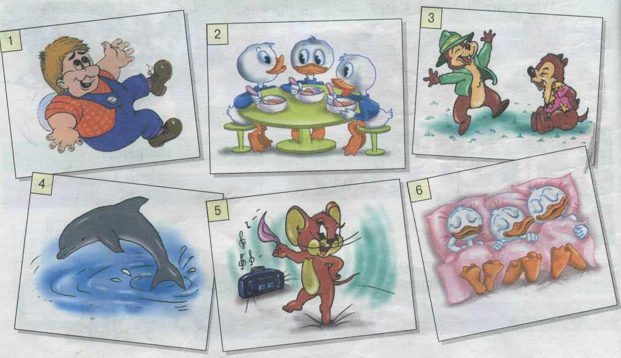
Look at the picture and answer the questions

Slide 8
Correct each sentence
They are usually wearing coats in winter
She is wear a beautiful dress now.
She usually wear gloves in winter.
Do you wearing a red shirt now?
What are you usually doing on Sunday?
What do you do now?
The weather is bad today, is it?
They are in the box, aren’t there?

Slide 9
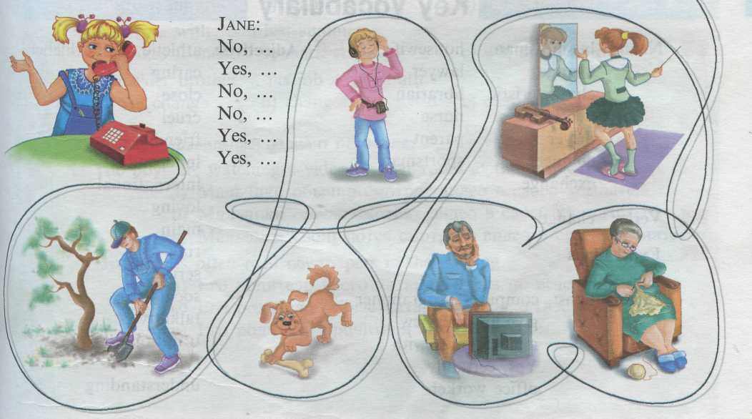
13. Look at the pictures. Write down the answers.
Mother:
Is John doing his homework?
Is Dad working in the garden?
Is Nancy playing the violin?
Is Sparky sleeping?
Is grandma knitting?
Is grandpa watching a football match?

Slide 10
Homework
Ex .11 ,p 55 .Write the verbs in Ing –form
Ex 27, p 49.Read and translate the texts.

